Slide 1
Domain Knowledge

Slide 2

Language
Platform
Technology
Framework
Application
Domain

Slide 3
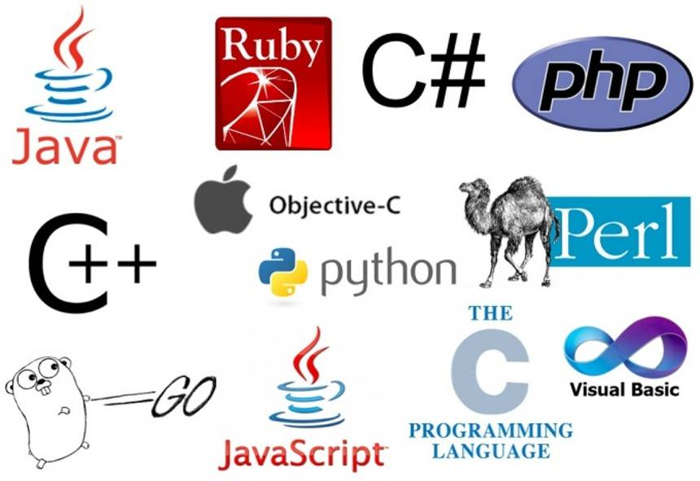
Language
A computer language is a communication medium between computer and human being. Consist of set of instructions to convey the actions to a computer.
Example:
Low level, Assembly Level, High Level (Procedural, Functional, Object-Oriented).
C, C++, Java, Python, PERL, JavaScript, C#, Visual Basic, HTML, XML, etc

Slide 4
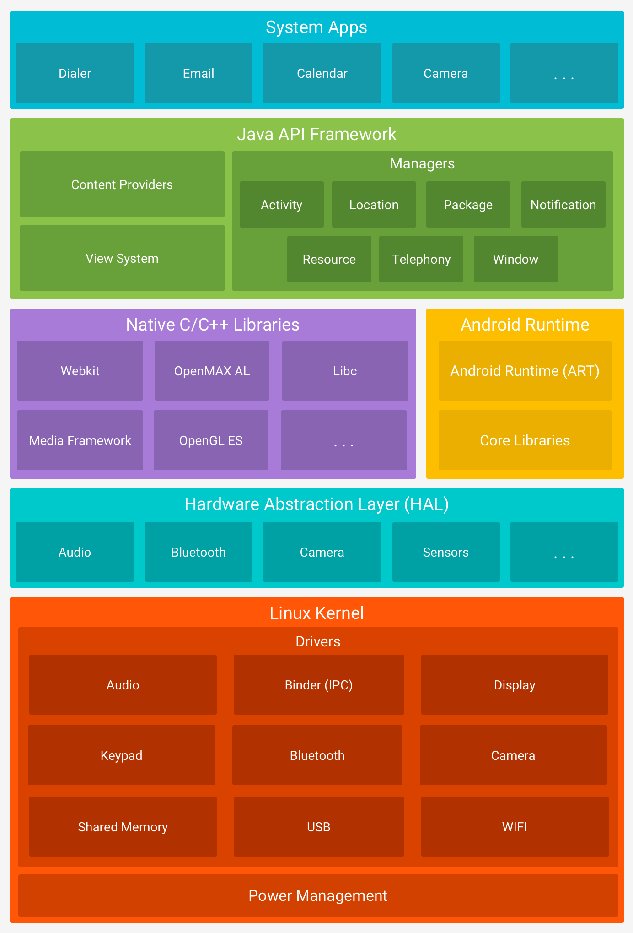
Platform
A computer platform is a system that consists of a hardware device and an operating system that an application, program or process runs upon.
Ex: Hardware + OS and the derivatives such as Cloud Platform, Mobile Platform

Slide 5
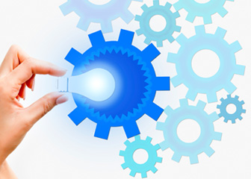
Technology
Technology can be most broadly defined as the entities, both material and immaterial, created by the application of mental and physical effort in order to achieve some value. In this usage, technology refers to tools and machines that may be used to solve real-world problems.
The definition of technology is science or knowledge put into practical use to solve problems or invent useful tools.
Ex Java Technologies: Servlets, JSP, JSF, JMS, Java Mail, Java Beans, etc
Web Page Technologies: jQuery, AngularJS, CSS, etc

Slide 6
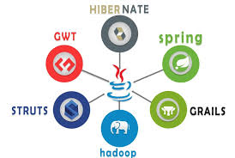
Framework
In computer programming, a software framework is an abstraction in which software providing generic functionality can be selectively changed by additional user-written code, thus providing application-specific software.
A software framework is a concrete or conceptual platform where common code with generic functionality can be selectively specialized or overridden by developers or users.
Example: Spring, Angular, .Net, JEE, etc

Slide 7
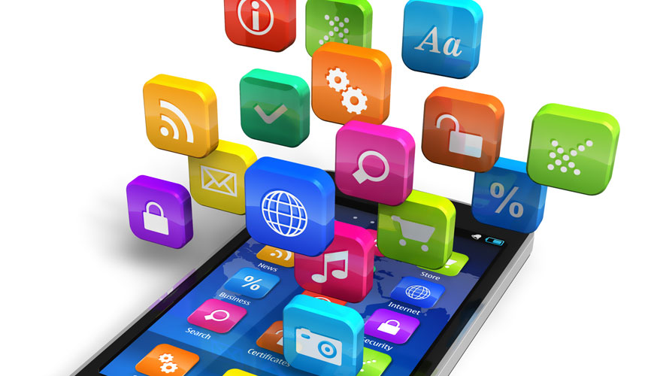
Application
Application software (app for short) is a program or group of programs designed for end users.
Example:
Applications in PC: Word, Power Point, Music Players, Databases, etc
Applications in Mobile

Slide 8
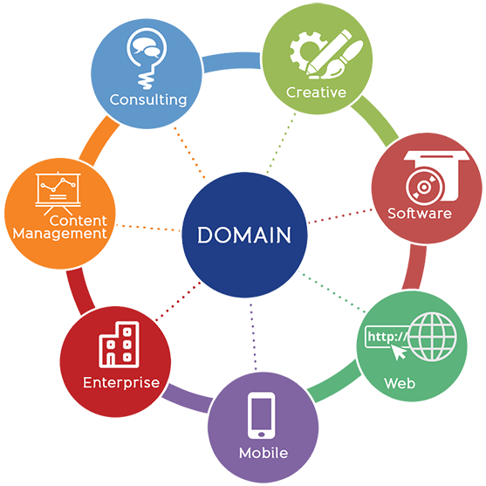
Domain
Domain in the realm of software engineering commonly refers to the subject area on which the application is intended to apply. In other words, during application development, the domain is the "sphere of knowledge and activity around which the application logic revolves.“
Examples: Data Mining, Image Processing, Embedded Systems, Networking (Telecom, IOT, Sensor, Adhoc, Mobile, etc), Cloud Computing, Finance, Aerospace, Insurance, Robotics, Cyber Security, AI, Big Data Analytics, Application, Bioinformatics, Medical Devices etc

Slide 9
Domains
Cloud Computing
Internet of Things (IoT)
Blockchain

Slide 10
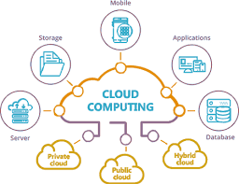
Trends in cloud computing
Serverless Computing
Quantum Computing
Hybrid Cloud
Containers (Docker, Kubernetes)
Microservices

Slide 11
Skills in demand for cloud computing
Cloud Security
ML & AI
Serverless Architectures
Cloud Migration and Multi-cloud Deployment
Automation

Slide 12
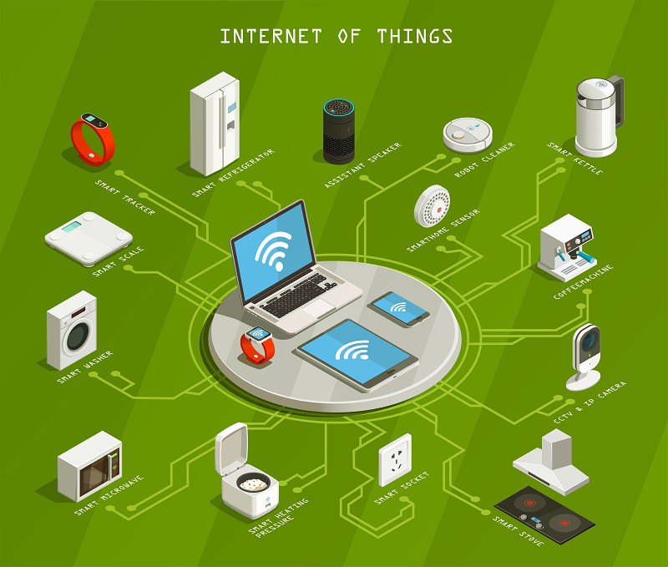
Trends in Internet of things (Iot)
Security
Edge Computing
Data analytics
SaaS (Software as a Service)
AI and Voice
Smart City
Industrial Automation
Smart home
Healthcare

Slide 13
Skills in demand for iot
Knowledge of Cloud Computing
ML & AI
Security and Cryptography
Bigdata and Analytics
JavaScript, Python, Java

Slide 14
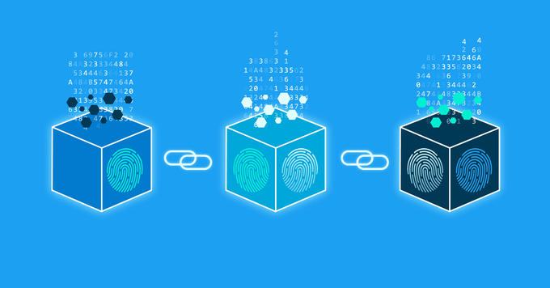
Trends in Blockchain
Blockchain as a Service (BaaS)
Interoperability and Blockchain Networks
Blockchain combines with IOT
Blockchain with AI
Applying Blockchain as a solution

Slide 15
Skills in demand for Blockchain
Blockchain Architecture
Data Structures
Smart Contract Development
DApps (Blockchain Distributed App) Development
Cryptography
Web Development

Slide 16
Leading front-end programming languages for 2020
HTML
CSS
JavaScript
Web Assembly

Slide 17
POPULAR WEB FRAMEWORK FOR FRONT-END IN 2020
React.js
Angular.js
Node.js

Slide 18
TOP IN-DEMAND BACK-END PROGRAMMING LANGUAGES
Python
Java
PhP
C#

Slide 19
ANDROID & iOS MOBILE App DEVELOPMENT TRENDS
Kotlin
Java
Swift (iOS)

Slide 20
THE TOP PROGRAMMING LANGUAGES FOR CROSS-PLATFORM DEVELOPMENT & DATA SCIENCE
Rust
Dart
Ruby
Typescript
Clojure
Elixir
Go Lang
R
C/C++

Slide 21
Thank You

